Slide 1
On the Excellence of Men Francois Poullain de la Barre
Amitpal Singh & Stephanie Porowski

Slide 2
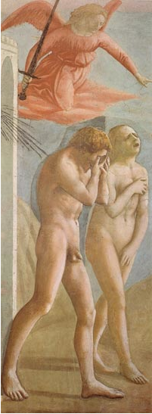
Tradition vs. Tradition
Creation (Genesis) “man applies equally to male and female” p.268
Adam - “emerged from the mud and the slime of the earth” p.271
Eve - resisted the devil while Adam did not, yet she “was the most unfortunate...she lost her liberty in becoming subservient to him” p. 275

Slide 3
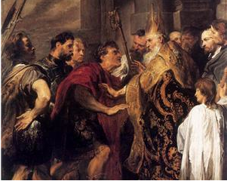
Scripture
Clement of Alexandria: men and women are of the same nature and have the same power in acting and practicing virtue p.266
Basil of Caesarea: the soul is the root of strength; both men and women have the power to do good p.267
Ambrose: advantages only exist in the soul not within the body p. 267

Slide 4
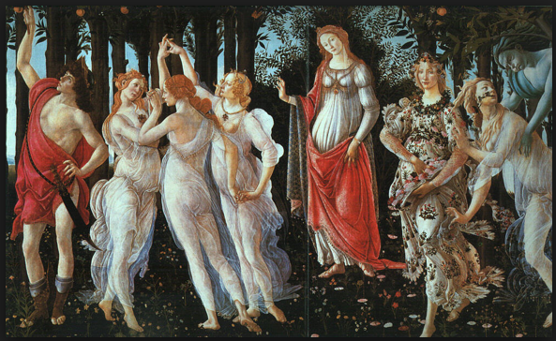
Nature
Custom
2 kinds of virtue - nature and convention When considering vice and virtue in nature there is no difference between the sexes
Poullain argues that by nature, men and women are equal; it is merely custom which informs men’s treatment of women in society : “According to this principle, setting custom aside, men and women have equal power over each other...” p.277

Slide 5
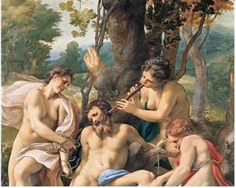
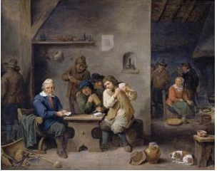
“Men have caused all of the evils of society and women have done nothing but follow their example” p.301
Women have a greater capacity for love than men
Women are more excellent than men, for they are the images of God in a more perfect way
Faults of Men

Slide 6
Ideal Love
Marriage: “This society is not founded on fear, but on love. A man and a woman do not seek each other out fearing that one might harm the other over ownership of external possessions; rather they seek to satisfy, through the possession of their own persons, a desire which banishes all fears, which gives them the mutual consideration of the most perfect friendship and which can be fully satisfied without entering into any kind of agreement that might cause division between them” p.280

Slide 8
“And if I just consider the way men have treated women, I am not sure they do not deserve, for their wisdom and their justice, to wear on their heads, they who are heads of families, the illustrious signs of their so-called excellence” p.314

Slide 9
Discussion
Poullain argues that women are no more prone to lawlessness than men. Today, society continues to maintain certain ideas of women, from which it is understood that they may not be able to conduct certain actions. Examples?
This treatise is entitled “On the Excellence of Men”. Can you think of any examples where Poullain discusses any examples of this?

Slide 10
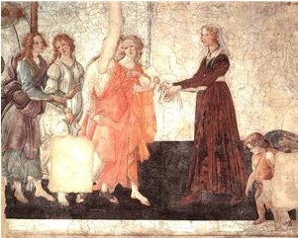
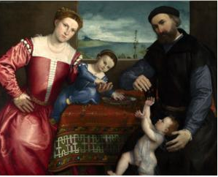
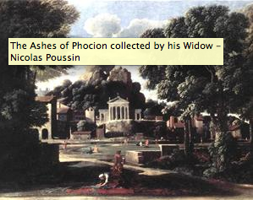
Marriage
“...you will be happy, exultant and will bless the day you were married and those who joined you to him if by your virtues, modesty and compliance you render yourself loveable to him”
“[Husbands] have laid claim to the position of authority and still cling to it...for they are no less subject to ignorance and disorder than those whom they have subjugated”

Slide 11
Mind/Body/Soul
“A woman’s mind is joined to her body, like a man’s, by God himself, and according to the same laws. Feelings, passions and the will maintain this union, and since the mind functions no differently in one sex than the other, it is capable of the same things in both”
“The greater nobility and worthiness of a woman’s body is shown by its delicacy, its complexion and its temperate nature, as well as by its beauty, which is a grace or splendour proceeding from the soul as well as the body”
“We can easily understand that knowledge is a universal quality...”

Slide 12
Nature
“...if we speak as philosophers, we will say that man’s soul is equally noble to woman’s because both are of the same species and therfore of the same nature and substance”
“Yet I will not say that the authority exercised over the sex is the same knid that Aristotle condemns (degenerating into tyranny), for I do not want to expose myself to the censure of those who rigidly observe custom, instead of conducting themselves according to reason”

